Slide 1

Cyclist Bike-Share Member Conversion Strategies

Slide 2
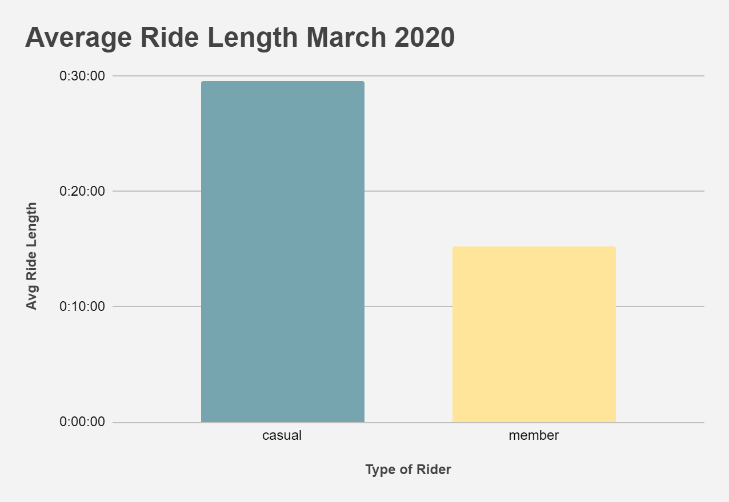
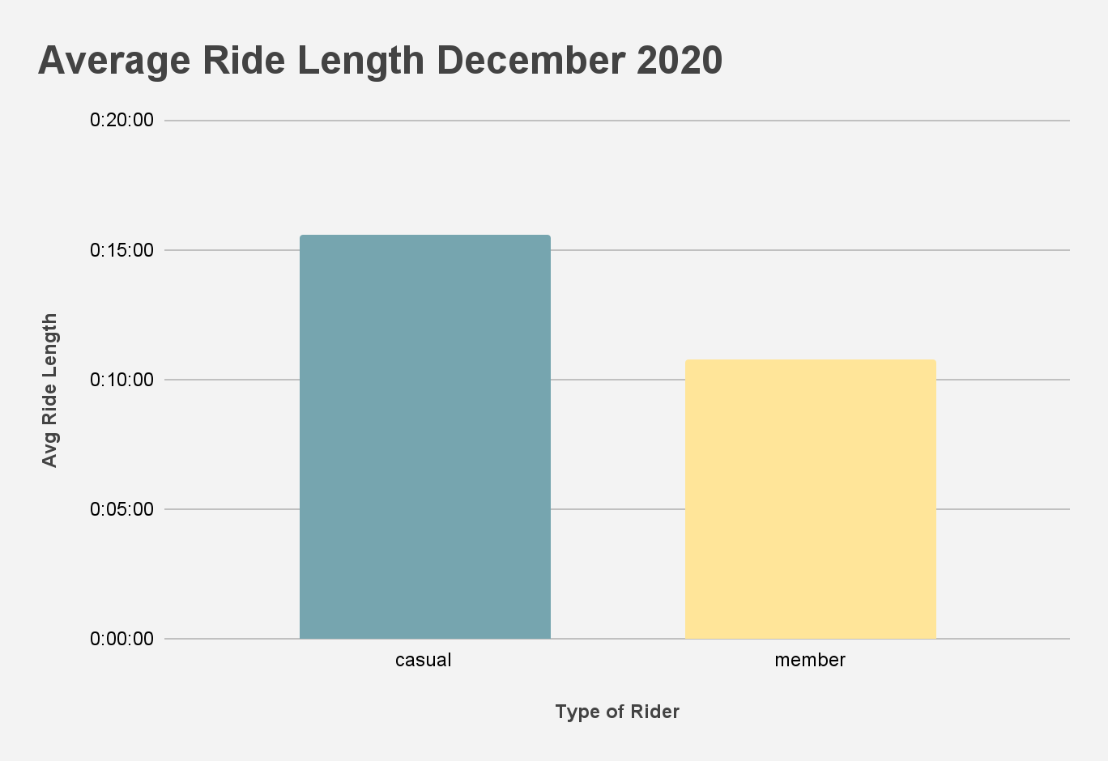
Who Rides Longer?
The average ride length for casual riders is longer than riders who are members.

Slide 3
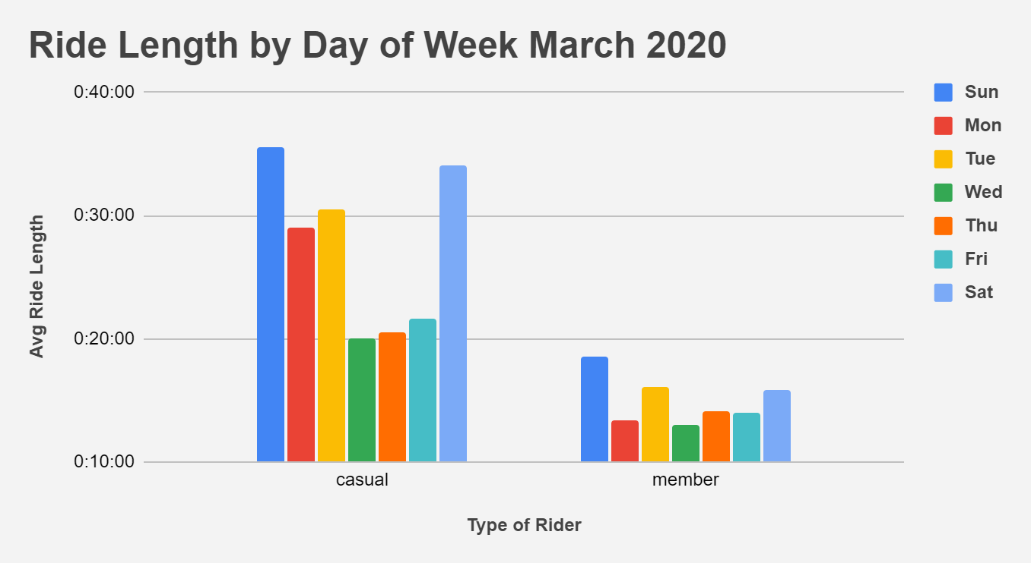
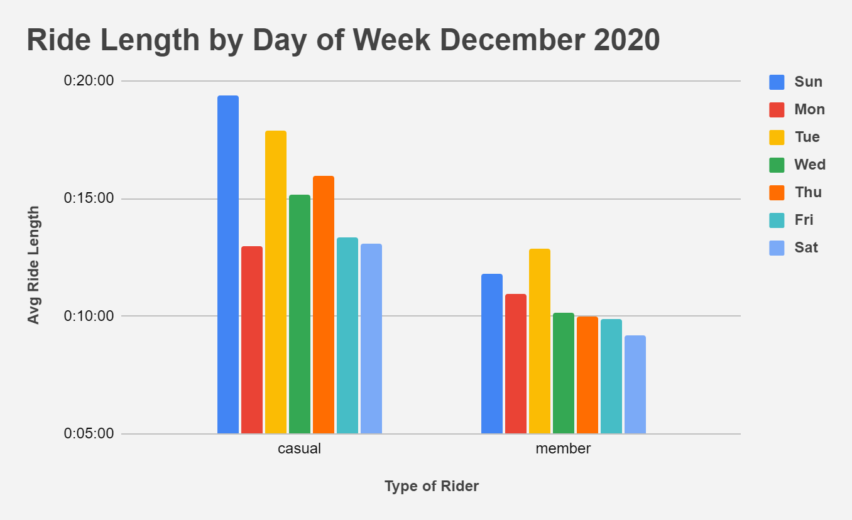
What Days Do People
Ride The Longest?
Both riders typically ride for the longest amount of time on the weekends, specifically Sunday.
Casual riders rode longer in March than in December.
Ride length for members stayed fairly similar.
In December, riders typically ride longer during the weekdays compared to March.

Slide 4
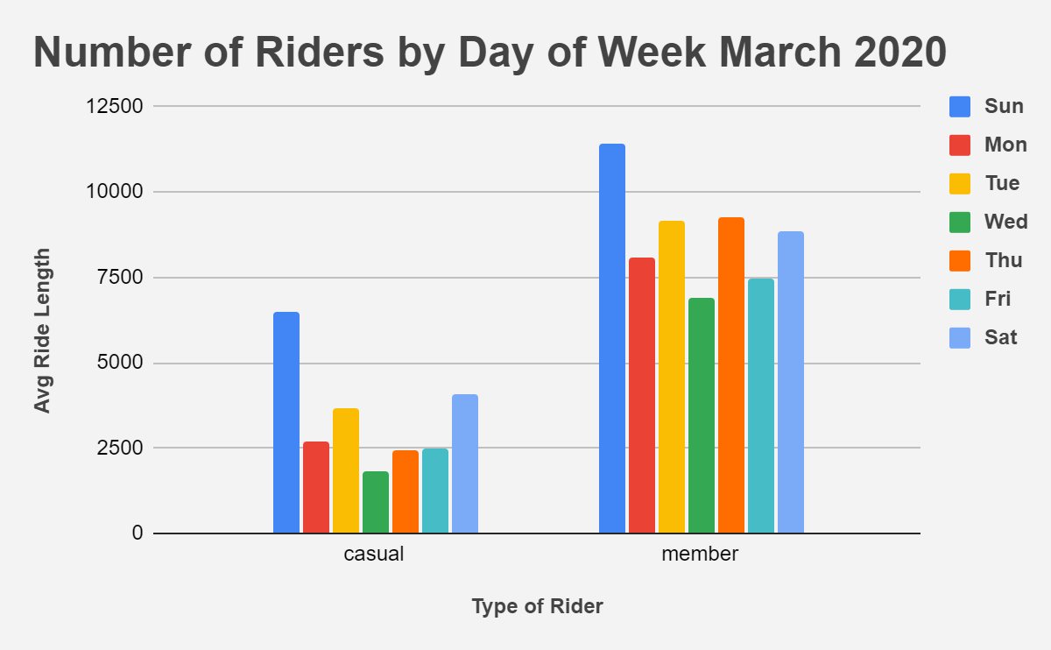
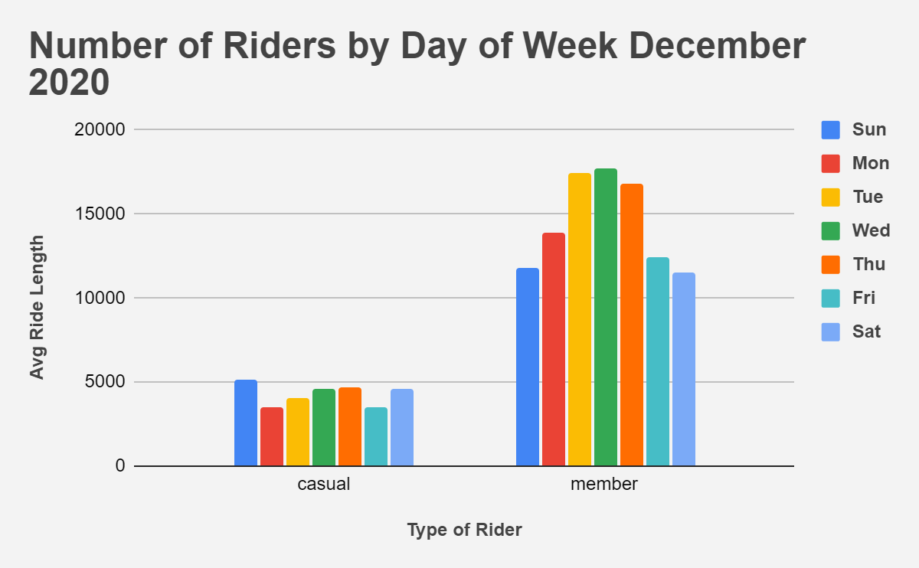
What Days Do The Most
Amount of People Ride?
Casual riders rode longer than members but there is a much larger number of riders who are members.
More people rode on the weekend in March while in December most people rode during weekdays.

Slide 5

How/Why Do Annual Members Ride?
There are more riders who are members but members also ride for the least amount of time.
The ride length for members is fairly consistent from spring to winter.
A large number of members ride during the weekday
In December the amount is even larger than on the weekend which is typically when ride length is the longest.
This suggests that members ride because it is necessary to commute to work and/or other scheduled activities.

Slide 6
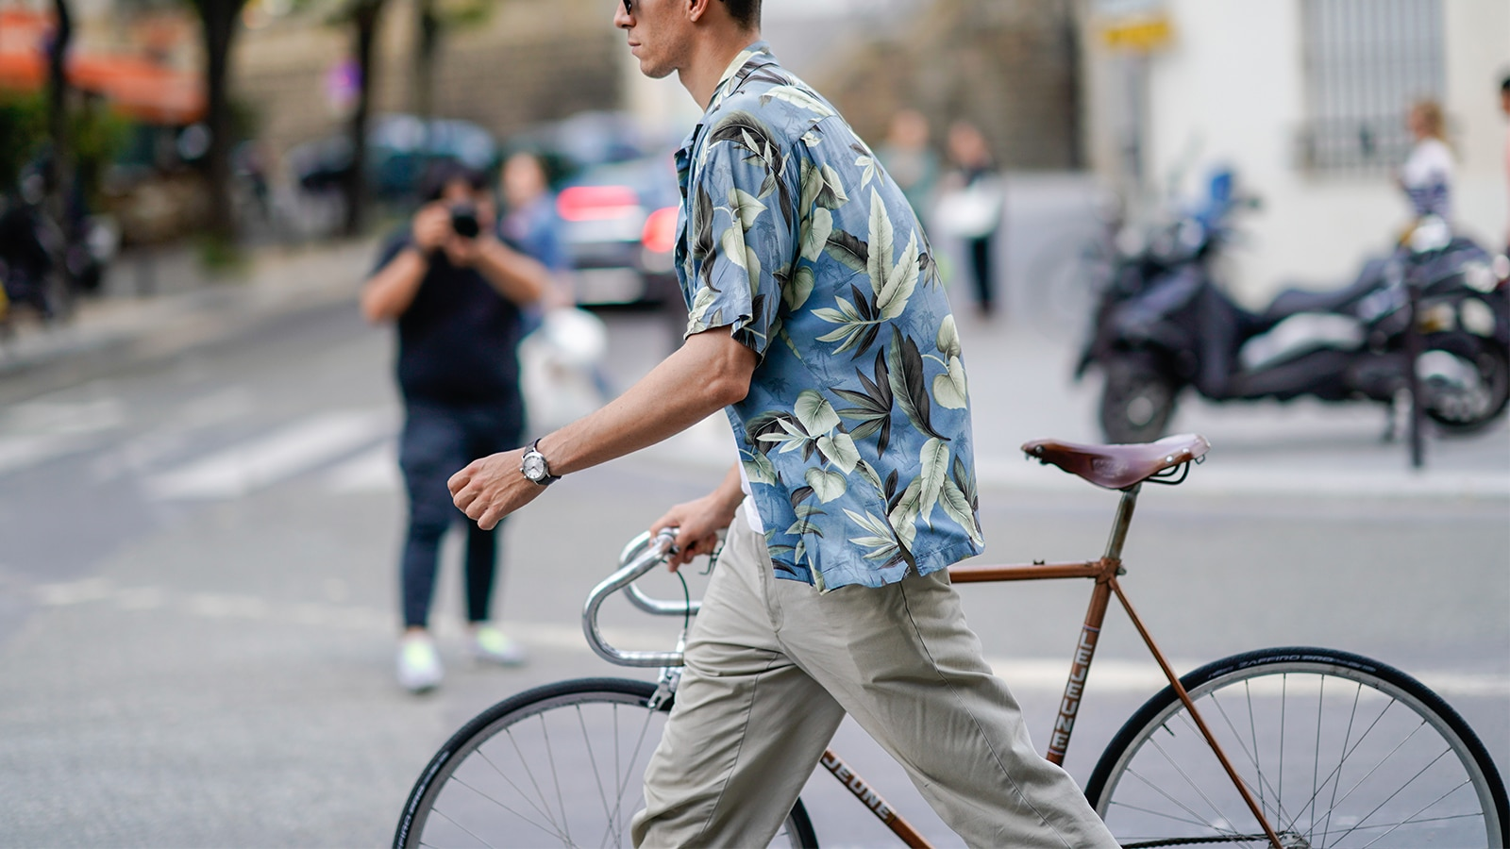
How/Why Do People Ride Casually?
Casual riders rode the longest but there are much less casual riders than members.
The ride length for casual riders was lower in December indicating that colder weather impacts how long they ride.
They also always rode the most on Sundays.
The number of casual riders is much lower than the number of members.
Casual riders ride their bikes longer than riders who are members.
All this indicates that casual riders are mostly using the bikes leisurely and not for work or other scheduled activities members.

Slide 7
Strategies To Convert Casual Riders Into Members
Members are using the bike share more consistently to go to places they are obligated to be, so advertising should show casual riders the bike-share service is a better alternative to public transportation or commuting by car.
More bike-shares should be placed in larger cities where people typically use public transport or walk so that there is higher chance that there is a station closer to someone's place of work or their home.
Since casual riders use the bike-share for leisure and they ride for the longest, some sort of membership plan should be implemented that allows people to save money or earn rewards through an app on their phone.
For example, every mile they ride they earn a reward or token that can be redeemed for money or other prizes to incentivize more memberships.

